Slide 1
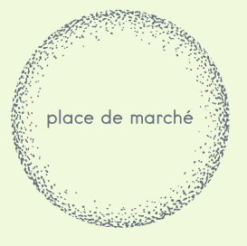
PROJET 6 :
Classifiez automatiquement des biens de consommation

Slide 2




SOMMAIRE :
I – LA Problématique
II – LES DONNÉES TEXTUELLES
III – LES DONNÉES VISUELLES
IV – CONCLUSION
2

Slide 3
I – LA Problématique :
3

Slide 4






























4

Slide 5
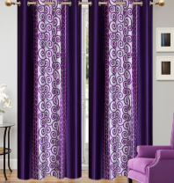
DONNÉES TEXTUELLES
DONNÉES VISUELLES
Key Features of Elegance Polyester Multicolor Abstract Eyelet Door Curtain Floral Curtain,Elegance Polyester Multicolor Abstract Eyelet Door Curtain (213 cm in Height, Pack of 2) Price: Rs. 899 This curtain enhances the look of the interiors.This curtain is made from 100% high quality polyester fabric.It features an eyelet style stitch with Metal Ring.It makes the room environment romantic and loving.This curtain is ant- wrinkle and anti shrinkage and have elegant apparance.Give your home a bright and modernistic appeal with these designs. The surreal attention is sure to steal hearts. These contemporary eyelet and valance curtains slide smoothly so when you draw them apart first thing in the morning to welcome the bright sun rays you want to wish good morning to the whole world and when you draw them close in the evening, you create the most special moments of joyous beauty given by the soothing prints. Bring home the elegant curtain that softly filters light in your room so that you get the right amount of sunlight.,Specifications of Elegance Polyester Multicolor Abstract Eyelet Door Curtain (213 cm in Height, Pack of 2) General Brand Elegance Designed For Door Type Eyelet Model Name Abstract Polyester Door Curtain Set Of 2 Model ID Duster25 Color Multicolor Dimensions Length 213 cm In the Box Number of Contents in Sales Package Pack of 2 Sales Package 2 Curtains Body & Design Material Polyester
CATEGORY = « HOME FURNISHING »
5

Slide 6
EST-CE POSSIBLE
?
(ÉTUDE DE FAISABILITÉ)
6

Slide 7
II – Données TEXTUELLES :
7

Slide 8

CORPUS et cible :
product_category_tree
descriptions
Home Furnishing
>>
Curtains & Accessories
>>
Curtains
>>
Elegance Polyester Multicolor Abstract Eyelet Do...
Key Features of Elegance Polyester Multicolor Abstract Eyelet Door Curtain Floral Curtain,Elegance Polyester Multicolor Abstract Eyelet Door Curtain (213 cm in Height, Pack of 2) Price: Rs. 899 This curtain enhances the look of the interiors.This curtain is made from 100% high quality polyester fabric.It features an eyelet style stitch with Metal Ring.It makes the room environment romantic and loving.This curtain is ant- wrinkle and anti shrinkage and have elegant apparance.Give your home a bright and modernistic appeal with these designs. The surreal attention is sure to steal hearts. These contemporary eyelet and valance curtains slide smoothly so when you draw them apart first thing in the morning to welcome the bright sun rays you want to wish good morning to the whole world and when you draw them close in the evening, you create the most special moments of joyous beauty given by the soothing prints. Bring home the elegant curtain that softly filters light in your room so that you get the right amount of sunlight.,Specifications of Elegance Polyester Multicolor Abstract Eyelet Door Curtain (213 cm in Height, Pack of 2) General Brand Elegance Designed For Door Type Eyelet Model Name Abstract Polyester Door Curtain Set Of 2 Model ID Duster25 Color Multicolor Dimensions Length 213 cm In the Box Number of Contents in Sales Package Pack of 2 Sales Package 2 Curtains Body & Design Material Polyester
8

Slide 9



EXTRACTION DES CATÉGORIES :
product_category_tree
Première ligne
Home Furnishing
>>
Curtains & Accessories
>>
Curtains
>>
Elegance Polyester
Multicolor
Abstract Eyelet Do...
7 catégories x 150 objets
9

Slide 10







EXTRACTION DES CATÉGORIES :
« Baby Care »
« Home Furnishing »
« Beauty &
Personal Care »
« Kitchen & Dining »
« Computers »
« Watches »
« Home Decor &
Festive Needs »
10

Slide 11

TRAITEMENTS Effectués (descriptions) :
Key Features of Elegance Polyester Multicolor Abstract Eyelet Door Curtain Floral Curtain,Elegance Polyester Multicolor Abstract Eyelet Door Curtain (213 cm in Height, Pack of 2) Price: Rs. 899 This curtain enhances the look of the interiors.This curtain is made from 100% high quality polyester fabric.It features an eyelet style stitch with Metal Ring.It makes the room environment romantic and loving.This curtain is ant- wrinkle and anti shrinkage and have elegant apparance.Give your home a bright and modernistic appeal with these designs. The surreal attention is sure to steal hearts. These contemporary eyelet and valance curtains slide smoothly so when you draw them apart first thing in the morning to welcome the bright sun rays you want to wish good morning to the whole world and when you draw them close in the evening, you create the most special moments of joyous beauty given by the soothing prints. Bring home the elegant curtain that softly filters light in your room so that you get the right amount of sunlight.,Specifications of Elegance Polyester Multicolor Abstract Eyelet Door Curtain (213 cm in Height, Pack of 2) General Brand Elegance Designed For Door Type Eyelet Model Name Abstract Polyester Door Curtain Set Of 2 Model ID Duster25 Color Multicolor Dimensions Length 213 cm In the Box Number of Contents in Sales Package Pack of 2 Sales Package 2 Curtains Body & Design Material Polyester
Normalisation
elegance polyester multicolor abstract eyelet door curtain floral curtain elegance polyester multicolor abstract eyelet door curtain height pack curtain enhances look interiors curtain high polyester fabricit eyelet style stitch metal ringit make room environment romantic loving curtain ant wrinkle anti shrinkage elegant apparancegive home bright modernistic appeal design surreal attention sure steal heart se contemporary eyelet valance curtain slide smoothly draw apart first thing morning welcome bright sun ray want wish good morning whole world draw close evening create special moment joyous beauty given soothing print bring home elegant curtain softly filter light room get right amount sunlight elegance polyester multicolor abstract eyelet door curtain height pack general elegance designed door eyelet name abstract polyester door curtain set duster color multicolor dimension length box content package pack package curtain body design material polyester
Stop words
(+ d’autres en lien à la problématique)
Lemmatisation
(plutôt que Stemming)
11

Slide 12
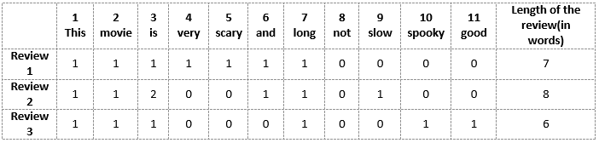
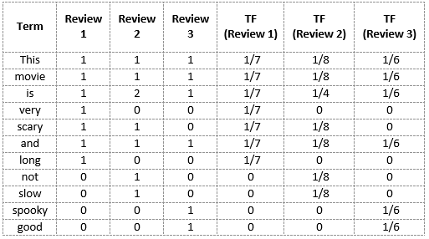
bag of words :
bag of words =
COUNT VECTORIZER
&
TF - IDF
12

Slide 13
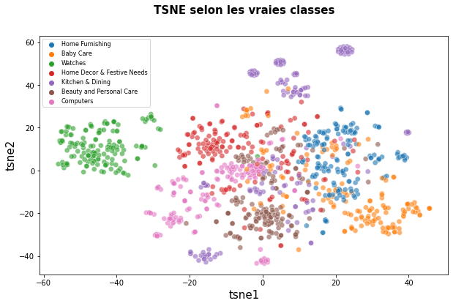
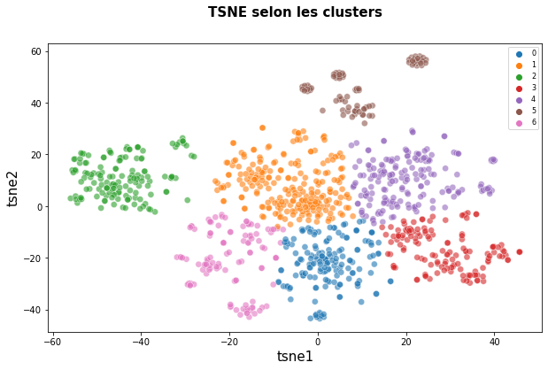
bag of words : COUNT VECTORIZER :
Score ARI = 0.4384
13

Slide 14
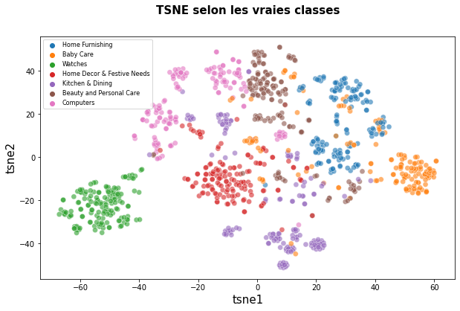
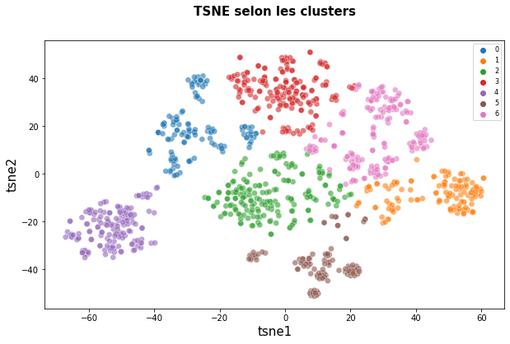
bag of words : TF – IDF (sans traitement)
Score ARI = 0.5567
14

Slide 15
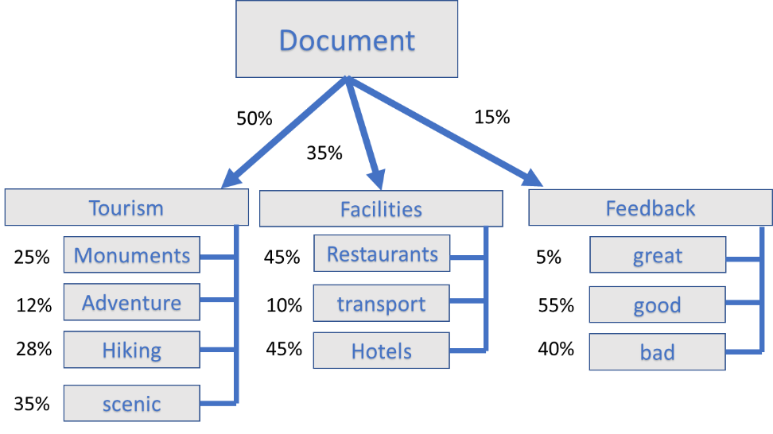
LATENT DIRICHLET ALLOCATION :
15

Slide 16
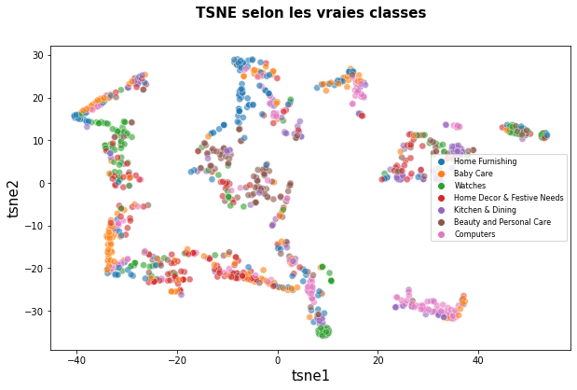
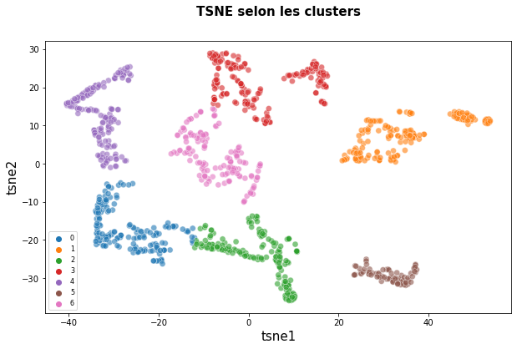
LDA : GENSIM LDA-MODEL
Score ARI = 0.1053
16

Slide 17
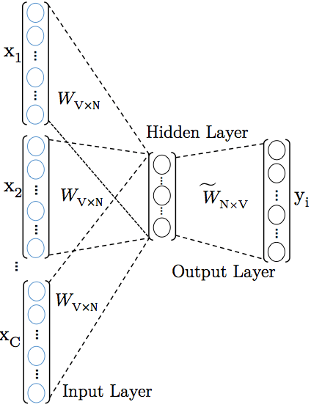
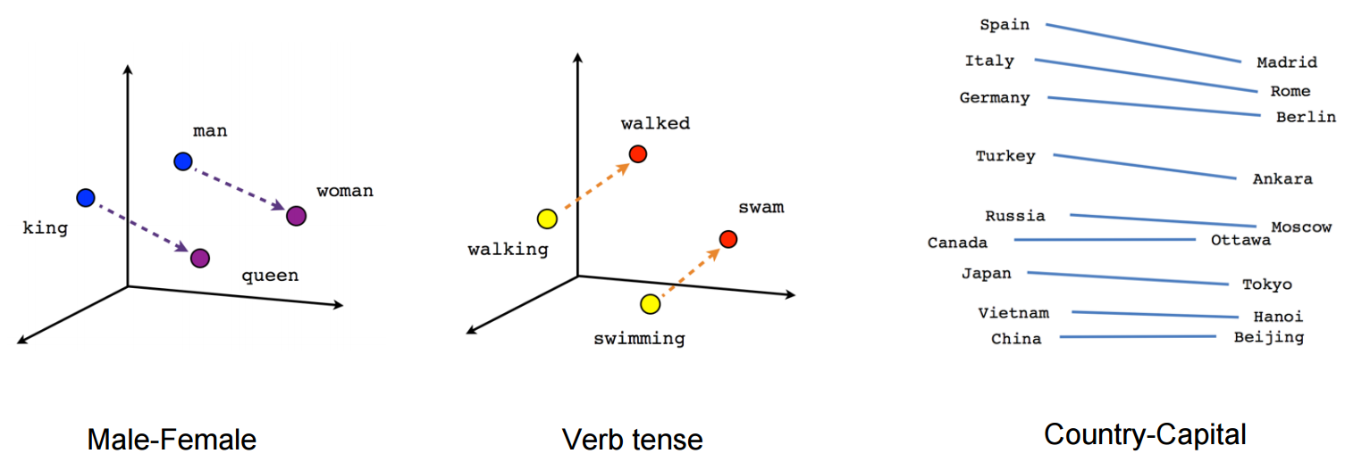
Word embeddings :
17

Slide 18
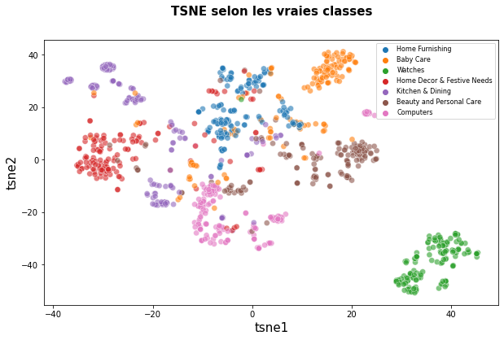
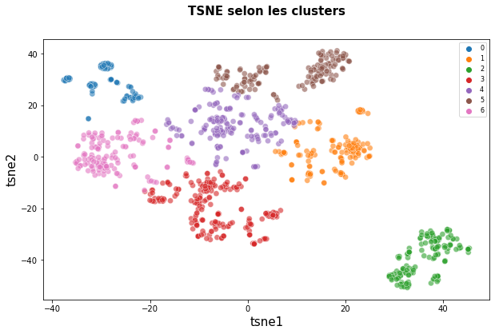
EMBEDDINGs : WORD2VEC
Score ARI = 0.5310
18

Slide 19
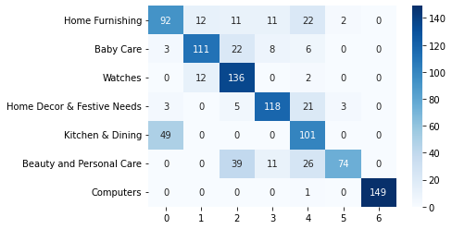
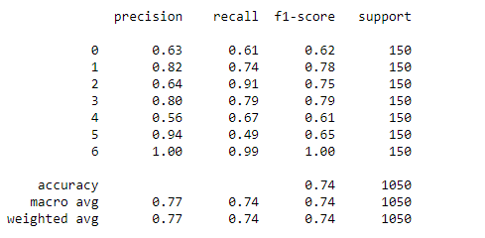
Embeddings : WORD2VEC
Score ARI = 0.5310
19

Slide 20
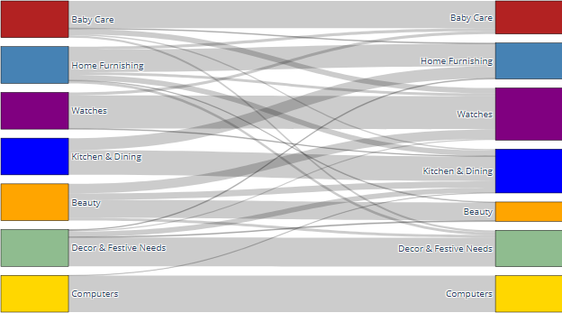
Embeddings : WORD2VEC
Score ARI = 0.5310
20

Slide 21
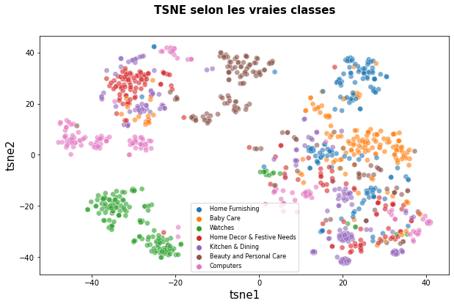
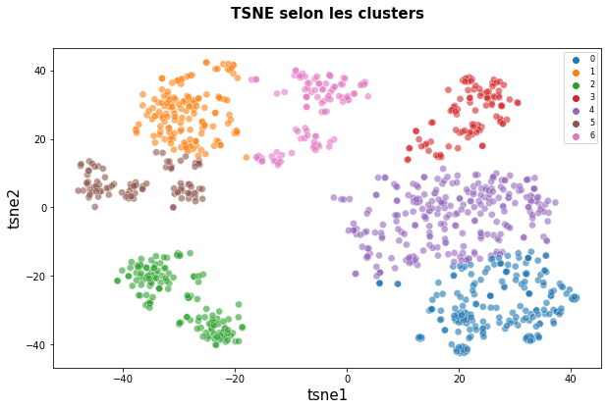
EMBEDDINGs : BERT HUNGER FACE
Score ARI = 0.3127
21

Slide 22
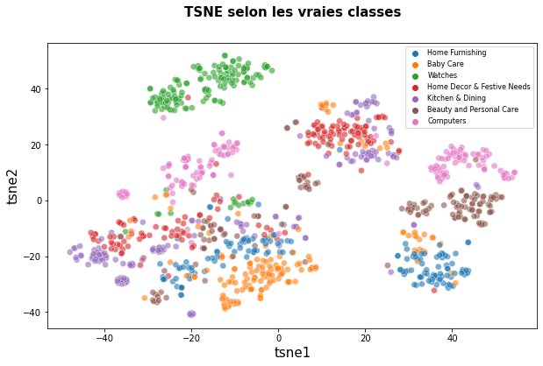
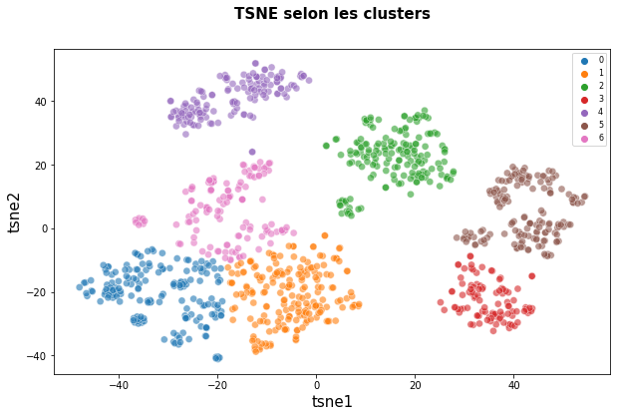
EMBEDDINGs : BERT HUB TENSORFLOW
Score ARI = 0.3567
22

Slide 23
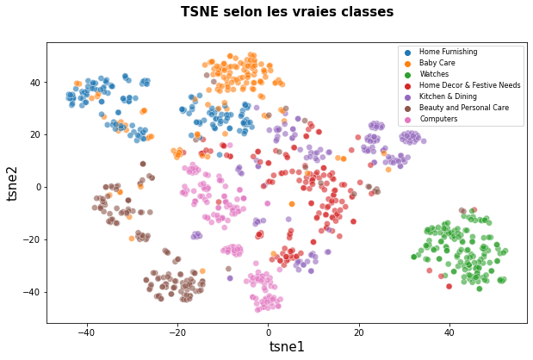
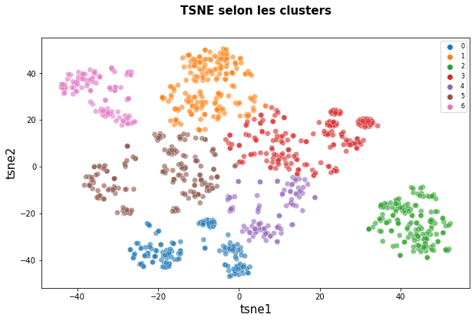
EMBEDDINGs : UNIVERSAL SENTENCE ENCODER
Score ARI = 0.4381
23

Slide 24
III – Données visuelles :
24

Slide 25
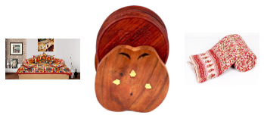
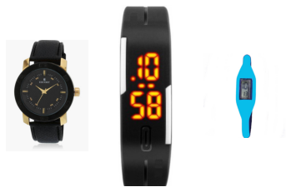
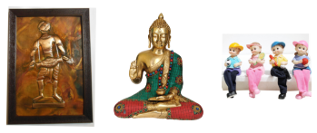
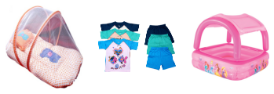
Aperçu des données :
Home furnishing
Watches
Baby Care
Home decore & festive needs
25

Slide 26
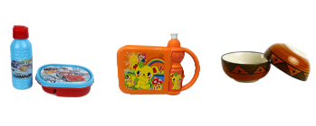
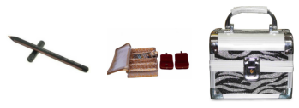
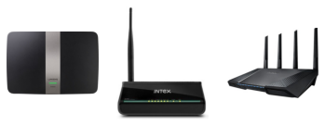
Aperçu des données :
Kitchen & dining
Beauty & personal Care
computers
26

Slide 27
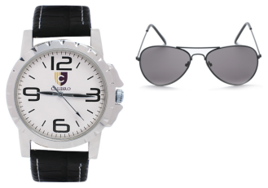
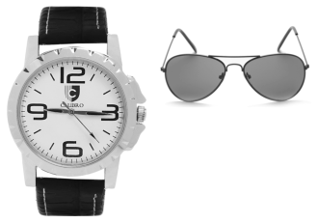
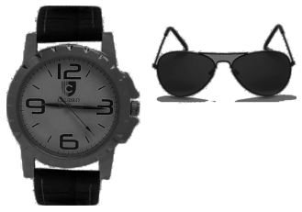
Modèle SIFT (preprocessing) :
ORIGINALE
NOIR ET BLANC
Équalisation
TRANSFORMATIONS
27

Slide 28
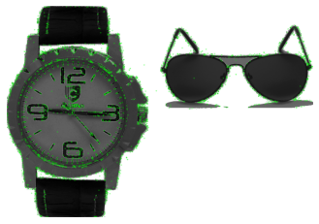
Modèle SIFT (preprocessing :
Détection de descripteurs
28

Slide 29
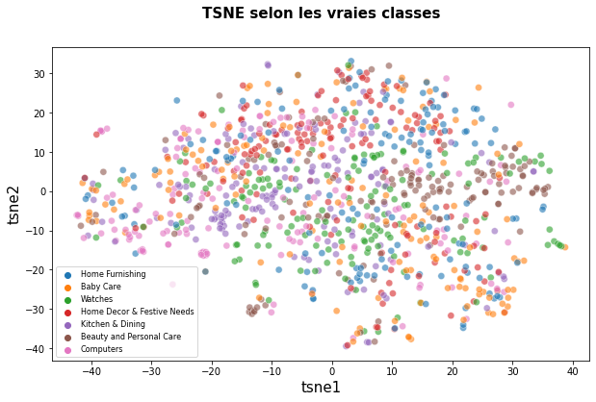
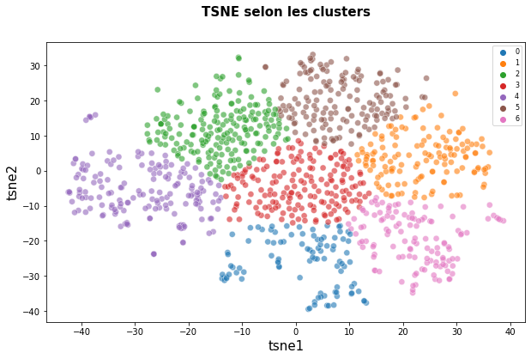
Modèle SIFT :
Score ARI = 0.06
29

Slide 30
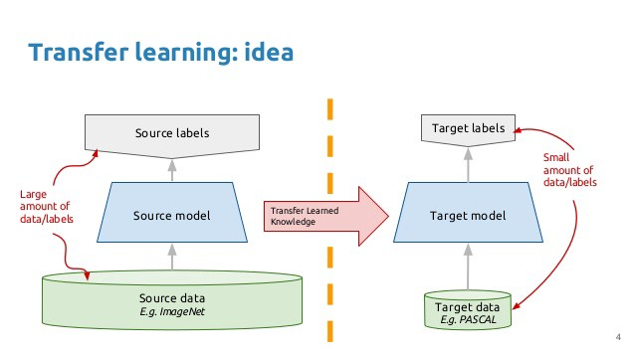
CNN IMAGE TRANSFER (VGG16) :
Utilisation d’un modèle pré-entraîné
30

Slide 31
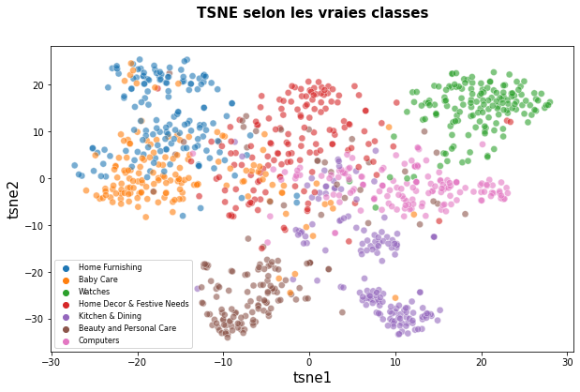
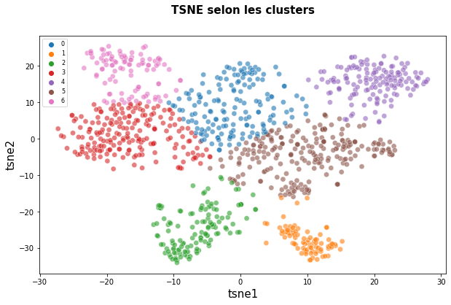
Modèle VGG16 :
Score ARI = 0.5175
31

Slide 32
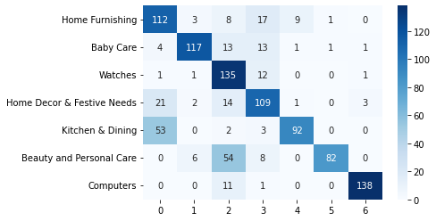
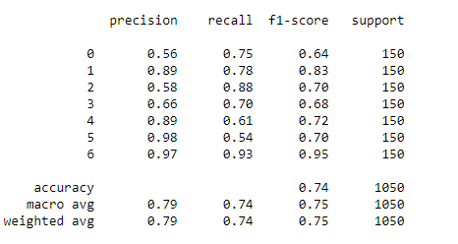
MEILLEUR Modèle : VGG16
Score ARI = 0.5175
32

Slide 33
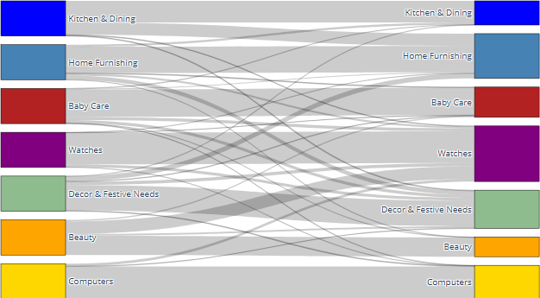
MEILLEUR Modèle : VGG16
Score ARI = 0.5175
33

Slide 34
IV – CONCLUSION :
34

Slide 35
UN modèle de classification automatique est-il ENVISAGEABLE ?
OUI !
35

Slide 36
Résultats de l’étude de faisabilité :
LA BASE DE DONNÉES DISPOSE D’ÉTIQUETTES SUR PLUSIEURS NIVEAUX
LES RÉSULTATS SUR LES DONNÉES TEXTUELLES ET VISUELLES SONT SATISFAISANTES
CES RÉSULTATS SONT TRÈS LARGEMENT AMÉLIORABLES
36

Slide 37
Préconisation pour la suite :
CHOISIR L’ÉTIQUETAGE CIBLE ET PEUT-ÊTRE L’AMÉLIORER
OPTIMISER LE PREPROCESSING
CHOISIR DES MODÈLES DE CLASSIFICATION EFFICACES (SVM ? RÉSEAUX DE NEURONES ?)
COMBINER LE NLP ET LA COMPUTER VISION EN UN SEUL MODÈLE PERFORMANT
37

